Slide 1
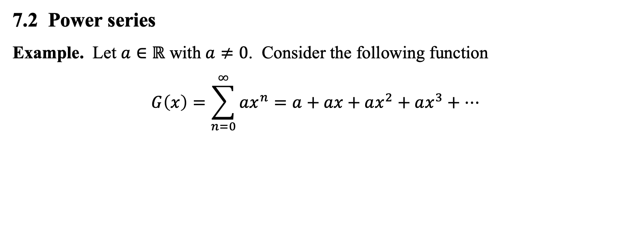
7.2 Power series
Example. Let $a∈ℝ$ with $a≠0$. Consider the following function
$$G\left(x\right)=\sum_{n=0}^{∞}{ax^{n}}=a+ax+ax^{2}+ax^{3}+⋯$$

Slide 2
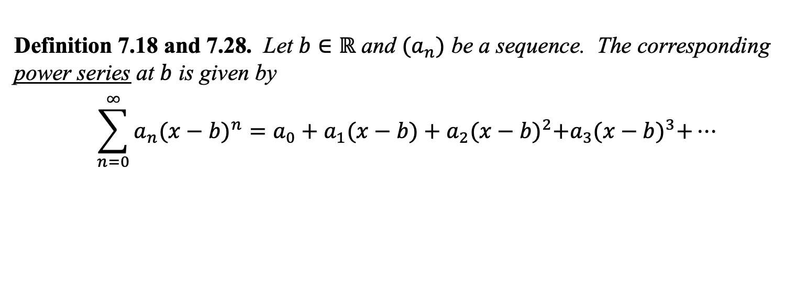
Definition 7.18 and 7.28. Let $b∈ℝ$ and $(a_{n})$ be a sequence. The corresponding power series at $b$ is given by
$$\sum_{n=0}^{∞}{a_{n}{(x−b)}^{n}}=a_{0}+a_{1}(x−b)+a_{2}{(x−b)}^{2}+a_{3}{(x−b)}^{3}+⋯$$

Slide 3
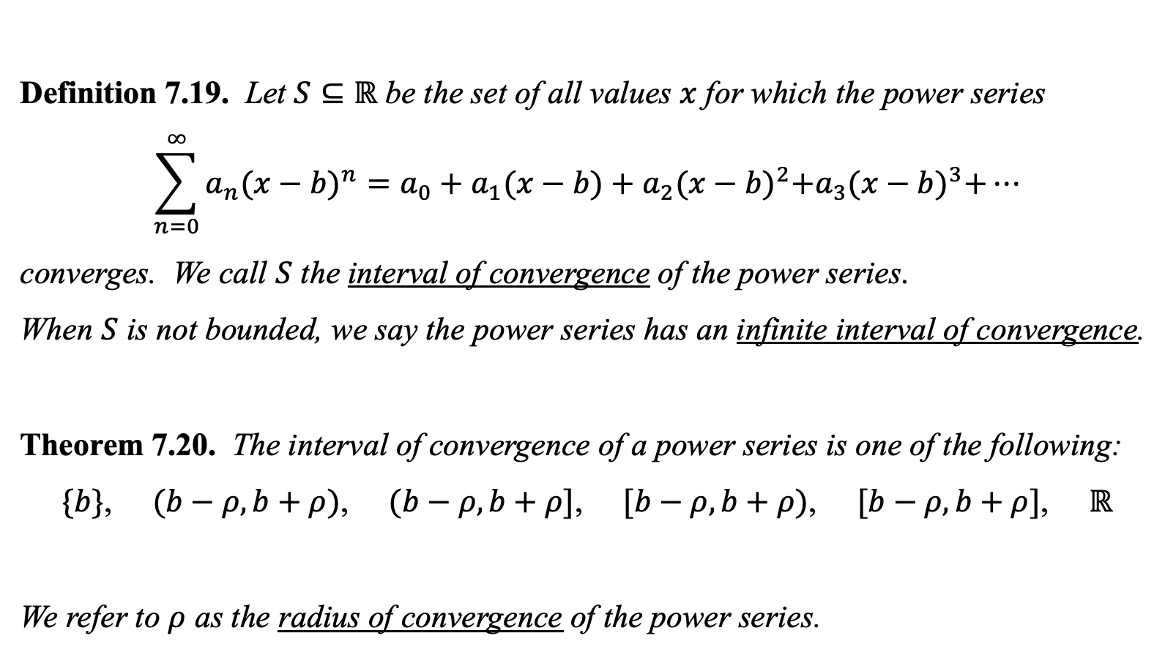
Definition 7.19. Let $S⊆ℝ$ be the set of all values $x$ for which the power series
$$\sum_{n=0}^{∞}{a_{n}{(x−b)}^{n}}=a_{0}+a_{1}(x−b)+a_{2}{(x−b)}^{2}+a_{3}{(x−b)}^{3}+⋯$$
converges. We call $S$ the interval of convergence of the power series.
When $S$ is not bounded, we say the power series has an infinite interval of convergence.
Theorem 7.20. The interval of convergence of a power series is one of the following:
$\{b\}$, $(b−ρ,b+ρ)$, $(b−ρ,b+ρ]$, $[b−ρ,b+ρ)$, $[b−ρ,b+ρ]$, $ℝ$
We refer to $ρ$ as the radius of convergence of the power series.

Slide 4
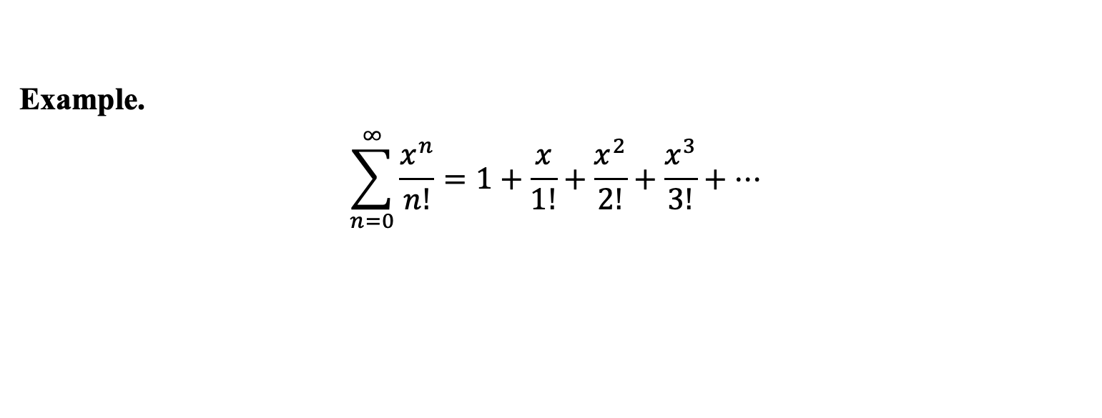
Example.
$$\sum_{n=0}^{∞}{\frac{x^{n}}{n!}}=1+\frac{x}{1!}+\frac{x^{2}}{2!}+\frac{x^{3}}{3!}+⋯$$

Slide 5
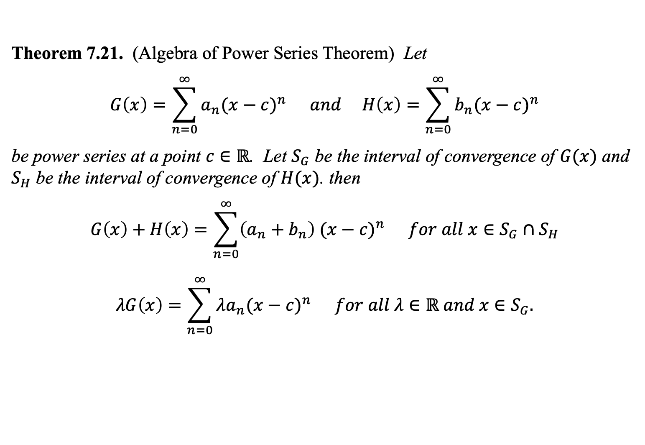
Theorem 7.21. (Algebra of Power Series Theorem) Let
$$G\left(x\right)=\sum_{n=0}^{∞}{a_{n}{(x−c)}^{n}} and H\left(x\right)=\sum_{n=0}^{∞}{b_{n}{(x−c)}^{n}}$$
be power series at a point $c∈ℝ$. Let $S_{G}$ be the interval of convergence of $G(x)$ and $S_{H}$ be the interval of convergence of $H(x)$. then
$$G\left(x\right)+H\left(x\right)=\sum_{n=0}^{∞}{\left(a_{n}+b_{n}\right){ (x−c)}^{n}} for all x∈S_{G}∩S_{H}$$
$$λG\left(x\right)=\sum_{n=0}^{∞}{{λa}_{n}{(x−c)}^{n}} for all λ∈ℝ and x∈S_{G}.$$

Slide 6
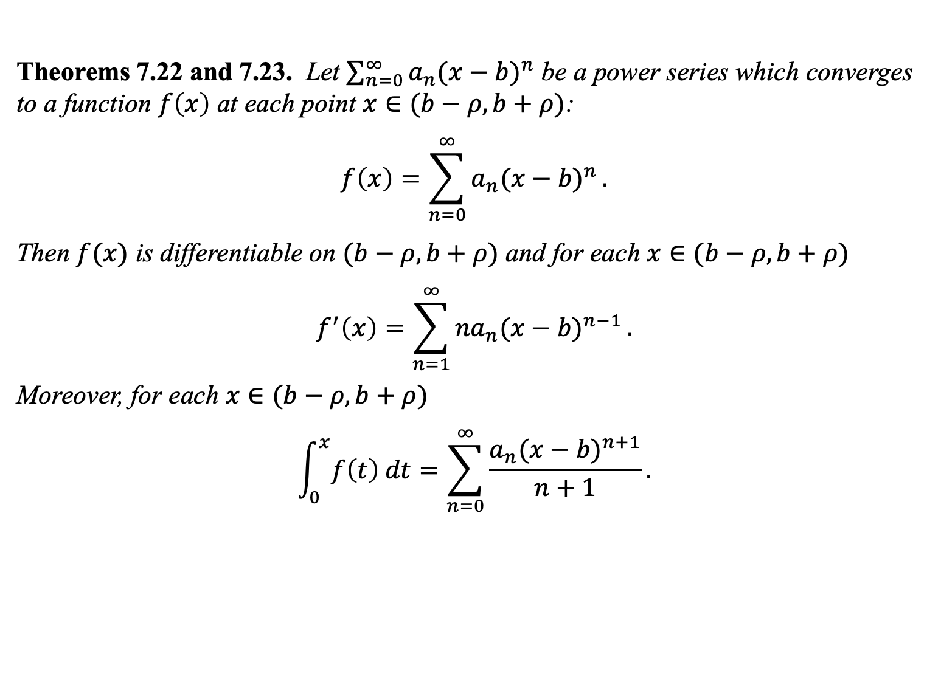
Theorems 7.22 and 7.23. Let $\sum_{n=0}^{∞}{a_{n}{(x−b)}^{n}}$ be a power series which converges to a function $f\left(x\right)$ at each point $x∈(b−ρ,b+ρ)$:
$$f\left(x\right)=\sum_{n=0}^{∞}{a_{n}{(x−b)}^{n}}.$$
Then $f(x)$ is differentiable on $(b−ρ,b+ρ)$ and for each $x∈(b−ρ,b+ρ)$
$$f^{′}\left(x\right)=\sum_{n=1}^{∞}{{na}_{n}{(x−b)}^{n−1}}.$$
Moreover, for each $x∈(b−ρ,b+ρ)$
$$\int_{0}^{x}{f\left(t\right) dt}=\sum_{n=0}^{∞}{\frac{a_{n}{(x−b)}^{n+1}}{n+1}}.$$

Slide 7
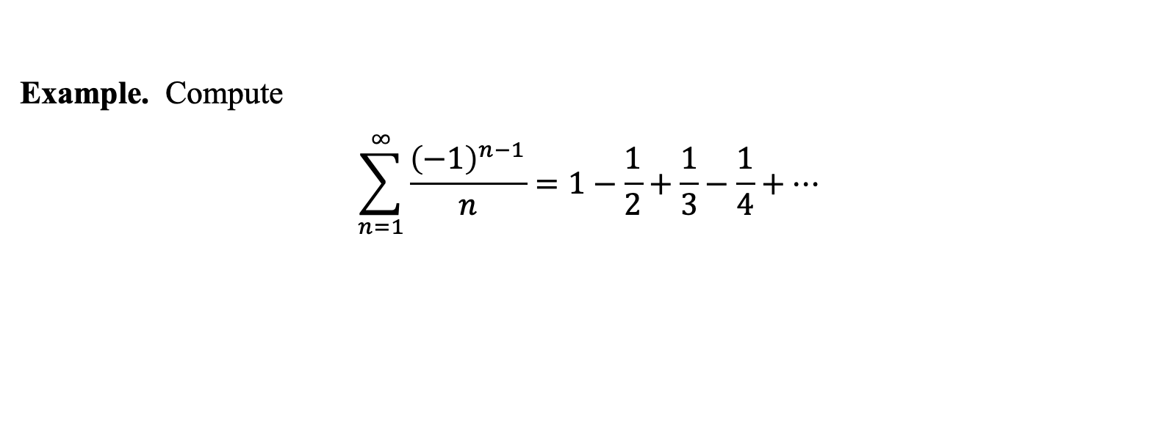
Example. Compute
$$\sum_{n=1}^{∞}{\frac{{\left(−1\right)}^{n−1}}{n}}=1−\frac{1}{2}+\frac{1}{3}−\frac{1}{4}+⋯$$

Slide 8
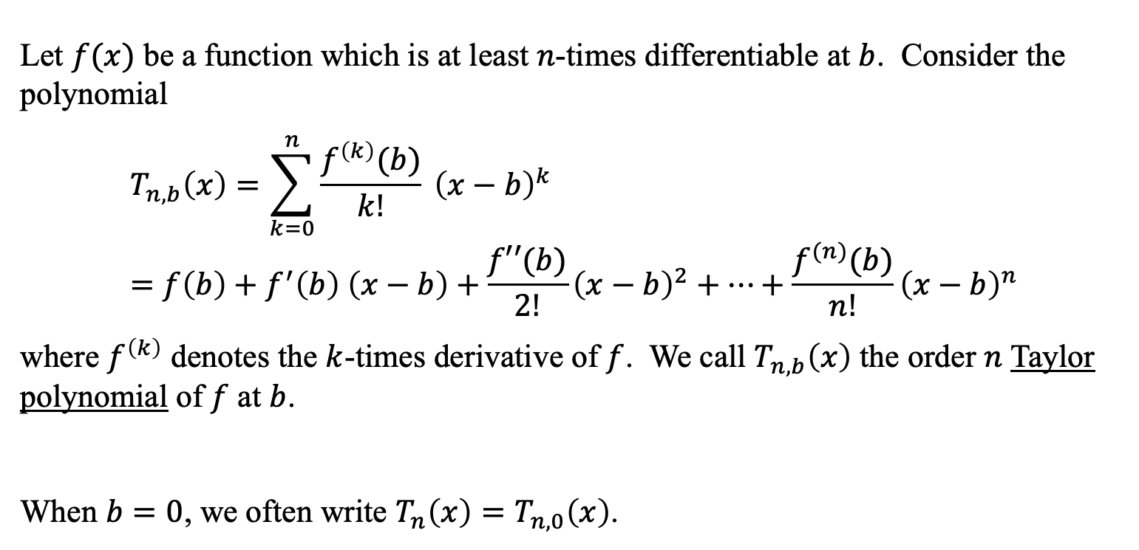
Let $f(x)$ be a function which is at least $n$-times differentiable at $b$. Consider the polynomial
$$T_{n,b}\left(x\right)=\sum_{k=0}^{n}{\frac{f^{\left(k\right)}(b)}{k!} {\left(x−b\right)}^{k}} \\ =f\left(b\right)+f^{′}\left(b\right) \left(x−b\right)+\frac{f′′(b)}{2!}{\left(x−b\right)}^{2}+⋯+\frac{f^{(n)}(b)}{n!}{\left(x−b\right)}^{n}$$
where $f^{\left(k\right)}$ denotes the $k$-times derivative of $f$. We call $T_{n,b}\left(x\right)$ the order $n$ Taylor polynomial of $f$ at $b$.
When $b=0$, we often write ${T_{n}\left(x\right)=T}_{n,0}\left(x\right)$.

Slide 9
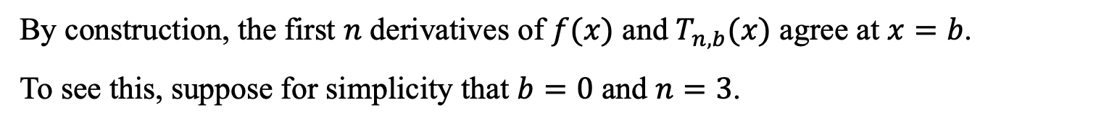
By construction, the first $n$ derivatives of $f(x)$ and $T_{n,b}(x)$ agree at $x=b$.
To see this, suppose for simplicity that $b=0$ and $n=3$.

Slide 10
Example. Find the Taylor polynomials of $f\left(x\right)=e^{x}$ at $0$.

Slide 11
Example. Find the order 3 Taylor polynomials of $f\left(x\right)=sin⁡(x)$ at $0$.

Slide 12
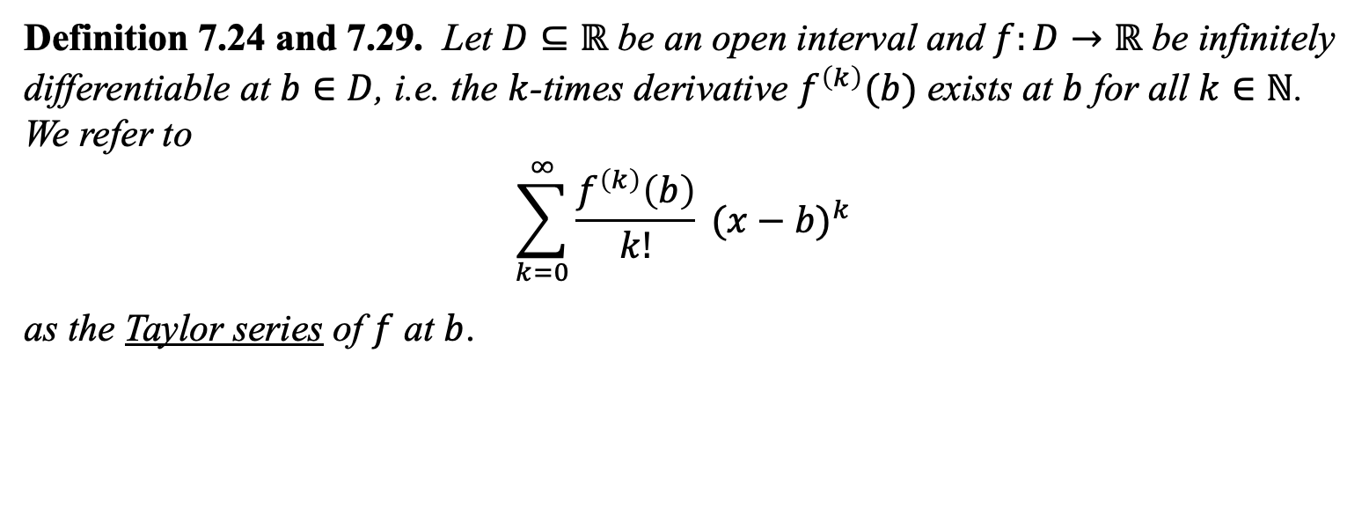
Definition 7.24 and 7.29. Let $D⊆ℝ$ be an open interval and $f:D→ℝ$ be infinitely differentiable at $b∈D$, i.e. the $k$-times derivative $f^{\left(k\right)}(b)$ exists at $b$ for all $k∈ℕ$. We refer to
$$\sum_{k=0}^{∞}{\frac{f^{\left(k\right)}\left(b\right)}{k!} {(x−b)}^{k}}$$
as the Taylor series of $f$ at $b$.

Slide 13
Example. Find the Taylor series of $f\left(x\right)=e^{x}$ at $0$.

Slide 14
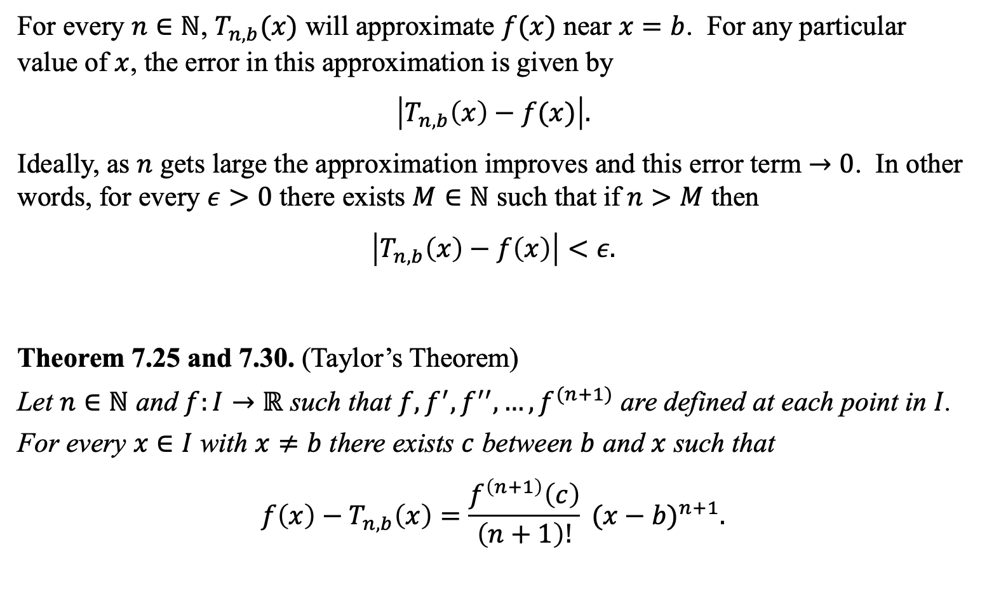
For every $n∈ℕ$, $T_{n,b}(x)$ will approximate $f(x)$ near $x=b$. For any particular value of $x$, the error in this approximation is given by
$$\left|T_{n,b}\left(x\right)−f(x)\right|.$$
Ideally, as $n$ gets large the approximation improves and this error term $→0$. In other words, for every $ε>0$ there exists $M∈ℕ$ such that if $n>M$ then
$$\left|T_{n,b}\left(x\right)−f\left(x\right)\right|<ε.$$
Theorem 7.25 and 7.30. (Taylor’s Theorem)
Let $n∈ℕ$ and $f:I→ℝ$ such that $f,f^{′},f^{′′},…,f^{(n+1)}$ are defined at each point in $I$.
For every $x∈I$ with $x≠b$ there exists $c$ between $b$ and $x$ such that
$$f\left(x\right)−T_{n,b}\left(x\right)=\frac{f^{\left(n+1\right)}\left(c\right)}{\left(n+1\right)!} {(x−b)}^{n+1}.$$

Slide 15
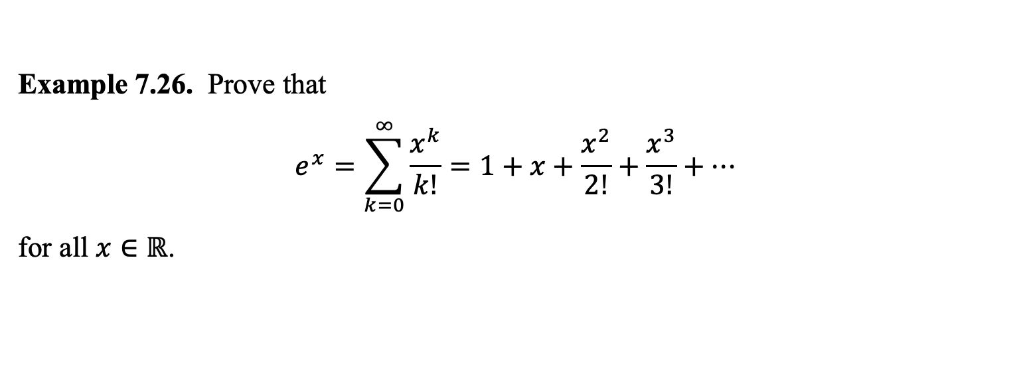
Example 7.26. Prove that
$$e^{x}=\sum_{k=0}^{∞}{\frac{x^{k}}{k!}=1+x+\frac{x^{2}}{2!}+\frac{x^{3}}{3!}+⋯}$$
for all $x∈ℝ$.

Slide 18

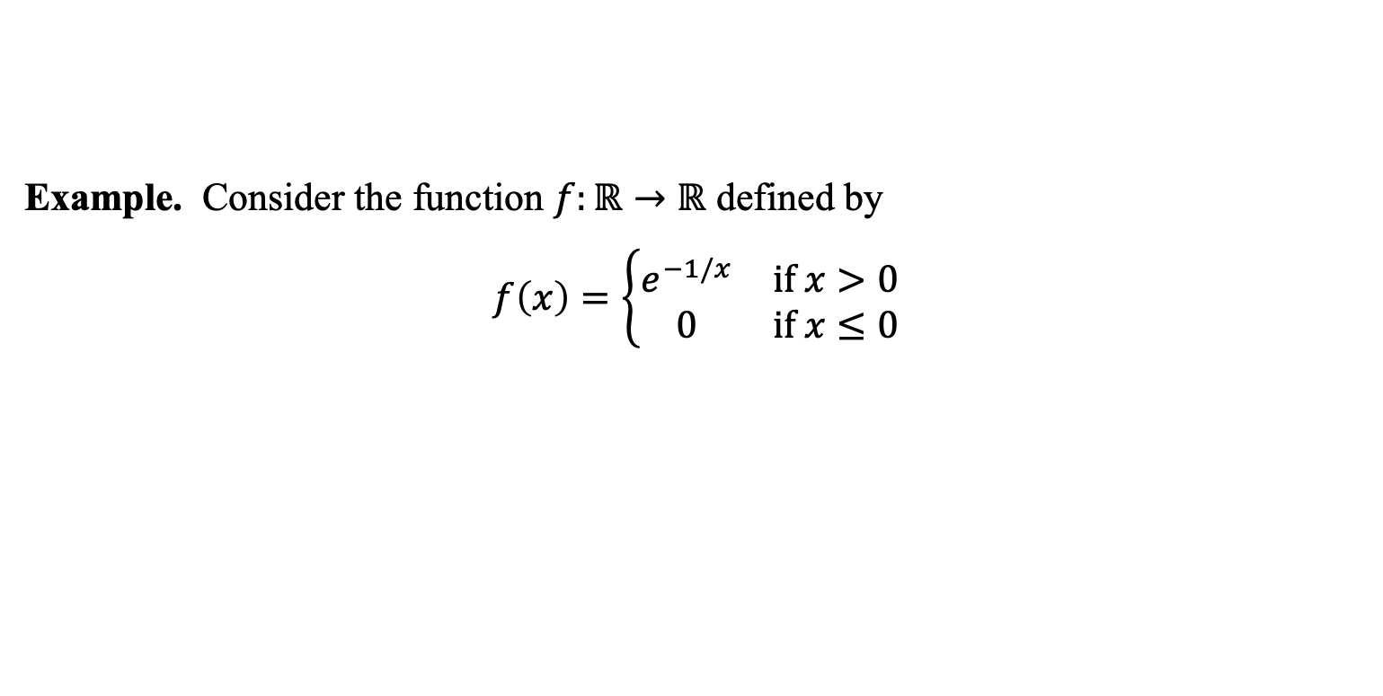
Example. Consider the function $f:ℝ→ℝ$ defined by
$$f\left(x\right)=\left\{\begin{matrix}e^{−1/x} & if x>0 \\ 0 & if x≤0\end{matrix}\right.$$
$$x$$

Slide 19
Example. Approximate $f\left(x\right)=sin⁡(x)$by a order 3 Taylor polynomials at $0$.

Slide 20
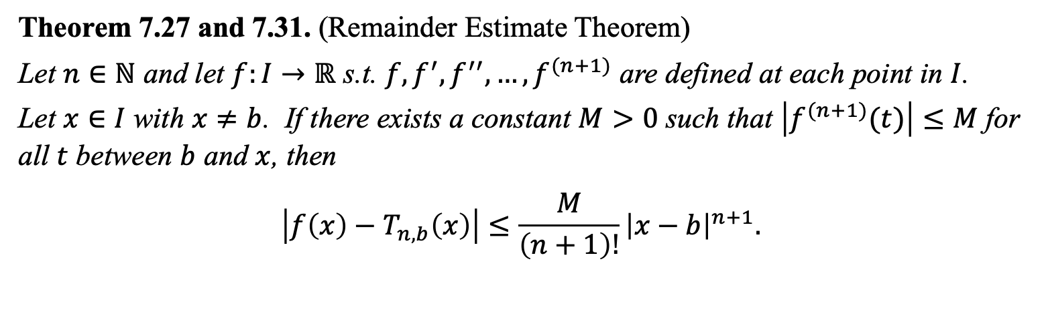
Theorem 7.27 and 7.31. (Remainder Estimate Theorem)
Let $n∈ℕ$ and let $f:I→ℝ$ s.t. $f,f^{′},f^{′′},…,f^{(n+1)}$ are defined at each point in $I$.
Let $x∈I$ with $x≠b$. If there exists a constant $M>0$ such that $\left|f^{(n+1)}(t)\right|≤M$ for all $t$ between $b$ and $x$, then
$$\left|f\left(x\right)−T_{n,b}\left(x\right)\right|≤\frac{M}{\left(n+1\right)!}{\left|x−b\right|}^{n+1}.$$

